Slide 1
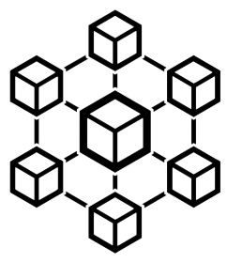
Introduction to
Microservices
created by
Rafed Muhammad Yasir
edited by
Toukir Ahammed

Slide 2
Things We Will Discuss
Monolithic Architecture
Examples of Monolithic Architectures
Challenges of a monolithic architecture
Microservices
Monoliths vs Microservices (example)
Advantages of Microservices
Companies Using Microservices
Best practices to design a monolithic architecture
Problems with Microservices
What to know next?

Slide 3
Monolithic Architecture
A monolithic architecture is a traditional model of a software program, which is built as a unified unit that is self-contained and independent from other applications.
A monolithic architecture is a singular, large computing network with one code base that couples all of the business concerns together.
To make a change to this sort of application requires updating the entire stack by accessing the code base and building and deploying an updated version of the service-side interface.

Slide 4
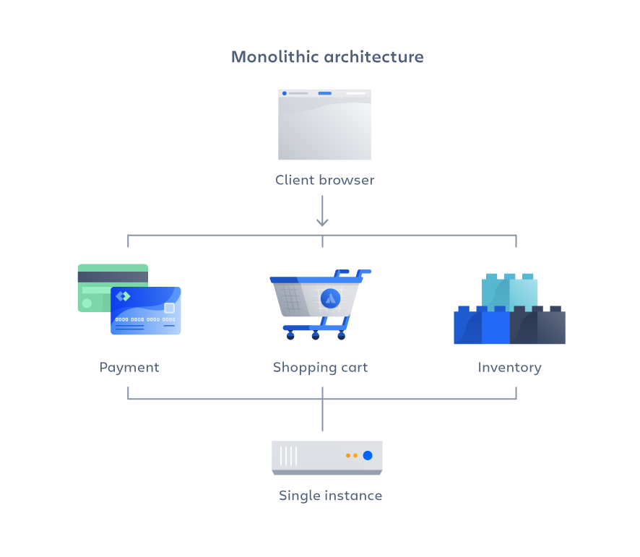
Monolithic Architecture

Slide 5
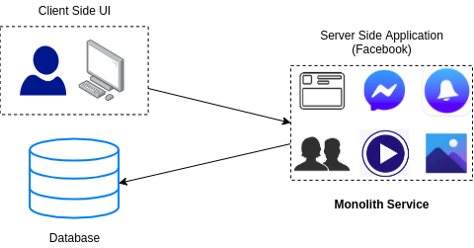
Monolithic Architecture
Monolithic architecture is like a big container where all the software components of an application are packaged together.
Notes:
Let’s start our discussion with monolithic architectures.
They are very tightly coupled
If any one feature of the app had not worked, the complete system would go down
Also, if only one feature had to be updated then the complete system had to be built again.

Slide 6


Examples of Monolithic Architectures
MVP
Minimum Viable Products
Router OS
Notes:
Wordpress, the worlds most popular website builder.
Routers typically employ monolithic operating systems that are not easily upgradable and extensible.

Slide 7
Advantages of a monolithic architecture
Easy deployment – One executable file or directory makes deployment easier.
Development – When an application is built with one code base, it is easier to develop.
Performance – In a centralized code base and repository, one API can often perform the same function that numerous APIs perform with microservices.
Simplified testing – Since a monolithic application is a single, centralized unit, end-to-end testing can be performed faster than with a distributed application.
Easy debugging – With all code located in one place, it’s easier to follow a request and find an issue.

Slide 8
Monolithic Architecture - Challenges
Large & Complex Applications
Slow Development
Blocks Continuous Deployment
Unscalable
Unreliable
Inflexible
Notes:
Large & Complex
Complex to understand
Difficult to modify
Development slows down
Modularity decreases over time
Difficult to understand how to correctly implement a change
Quality of code declines over time
Slow development
Application becomes difficult to understand and modify since they are huge and multiple teams work on it
Large codebase slows down IDE
If a small component had to be changed the entire application had to be repackaged together
Blocks continuous development
Top update one component you have to update the entire application, which interrupts background tasks
Background tasks interrupted means interruption of all components
Risk associated with redeployment increase discouraging frequent updates
Unscalable
Caching less effective coz Increased memory consumption
Different applications have different resource requirements, some are memory intensive some are cpu intensive
Cannot scale each component independently
Unreliable, since tightly coupled, if one component goes down the entire system will fail to run.
Unreliable
If one component fails, entire system collapses
Inflexible
Difficult to adopt new frameworks and languages

Slide 9
Disadvantages of a monolithic architecture
Slower development speed – A large, monolithic application makes development more complex and slower.
Scalability – You can’t scale individual components.
Reliability – If there’s an error in any module, it could affect the entire application’s availability.
Barrier to technology adoption – Any changes in the framework or language affects the entire application, making changes often expensive and time-consuming.
Lack of flexibility – A monolith is constrained by the technologies already used in the monolith.
Deployment – A small change to a monolithic application requires the redeployment of the entire monolith.

Slide 10
What are Microservices?

Slide 11
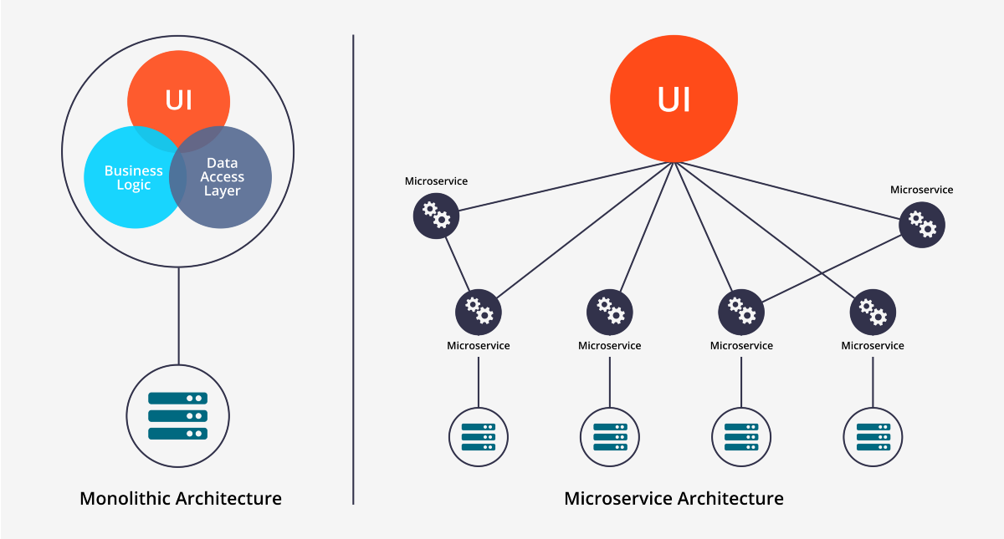
Microservices
Microservices are basically an architecture where a monolithic application is decomposed into small applications which are packaged and deployed independently
Notes:
Small autonomous services modeled around a business Domain.
Self contained and implements a single business capability
Separate teams handle separate features. Thus easier to deploy new features again and again whenever it is required.

Slide 12
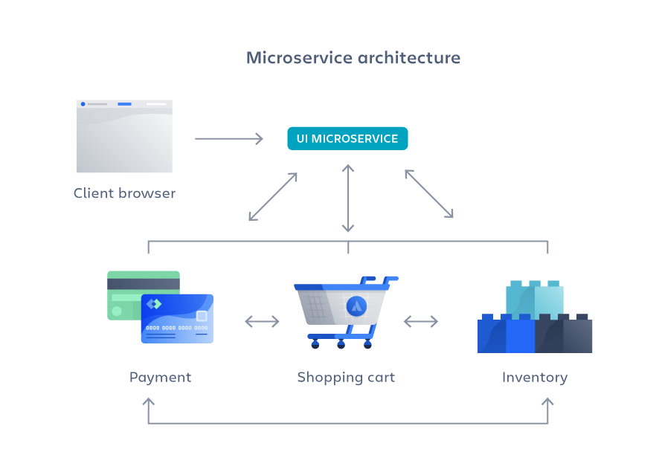
Microservice Architecture

Slide 13
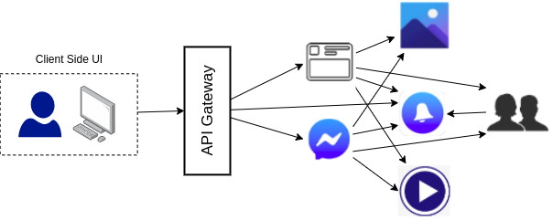
Microservices of Facebook

Slide 14
Advantages of Microservice
Independent development
Independent & continuous deployment
Fault isolation
Mixed technology stack
Granular scaling
Agility
Notes:
Services can be scaled independently

Slide 15

Companies Using Microservices

Slide 16
Microservice Architecture - Best Practices
Separate data store for each microservice
Keep code at a similar level of maturity
Separate build for each microservice
Deploy in containers
Treat servers as stateless

Slide 17
Problems with Microservices

Slide 18
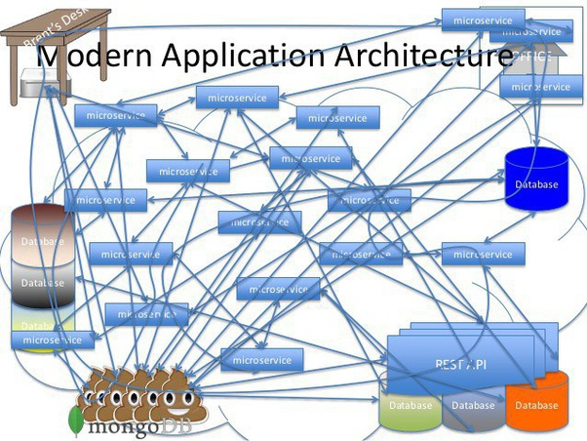

Slide 19
Q/A

